Slide 1
Humayun Ahmed Principal Software Engineer Cefalo School

Slide 2

Command Pattern

Slide 3
Command Pattern
Intent
Encapsulate a request as an object, thereby letting you parameterize clients with different requests, queue or log requests, and support undoable operations.

Slide 4
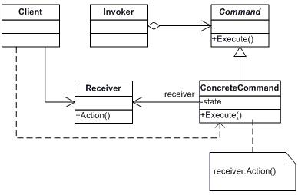
Command Pattern

Slide 5
Participants
Command declares an interface for executing an operation
ConcreteCommand defines a binding between a Receiver object and an action implements Execute by invoking the corresponding operation(s) on Receiver
Client creates a ConcreteCommand object and sets its receiver
Invoker asks the command to carry out the request
Receiver knows how to perform the operations associated with carrying out the request.

Slide 6
Homework
Implement Undo/Redo functionality for your application.
Build a small app to have CRUD operation on a list of string.
There should be a undo and a redo button which allows to undo or redo operation infinitely.

